Slide 1
Dive Into Fabric Lakehouse
Notes:
This deck is a template for What The Hack lectures.
It is recommended that Coaches deliver mini-lectures ahead of each Challenge that set context for the challenge and introduce & explain any key technologies.
At a minimum, it is handy to have a slide with the key goals of each challenge to display on the screen when running the hack in-person.

Slide 2
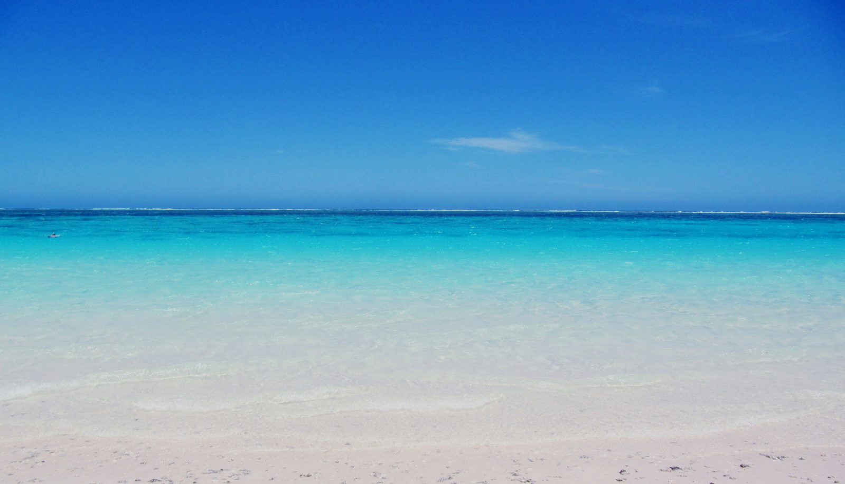
Dive Into Microsoft Fabric Lakehouse
Notes:
Alt title slide
Image: https://commons.wikimedia.org/wiki/File:La_mer_%C3%A0_Exmouth_WA.JPG#filelinks

Slide 3

<Insert Hack Name Here>
Welcome & Intros
<Coach Name>
<Coach Name>
<Coach Title>
<Coach Title>
<Coach Name>
<Coach Name>
<Coach Title>
<Coach Title>
Notes:
Coaches/Presenters for THIS hack/lecture event should be listed on this slide.
Original contributors to the hack content & these slides include:
Liesel Hughes, Cloud Solution Architect, Microsoft
Please list original contributors to this hack here in the speaker notes and give them credit when delivering this content.

Slide 4
Welcome
Dive Into Microsoft Fabric Lakehouse
It’s time to make a “splash” and “dive” into Microsoft Fabric!
We’re Going Diving!
<Logistics Goes Here>
Notes:
Replace Logistics with anything specific for your location

Slide 5
Agenda
Indicative Times
9:30 am | 15 mins | Welcome!
9:45 am | 30 mins | An Overview of Microsoft Fabric
10:15 am | 15 mins | The Hack! & Challenge 0 – Get Your Gear Ready
10:30 am | 15 mins | Break
10:45 am | 45 mins | Challenge 1 – Finding Data
11:30 am | 60 mins | Challenge 2 – Land Ho!
12:00 pm | 60 mins | Lunch
1:00 pm | 30 min | Challenge 2 cont.
1:30 pm | 60 mins | Challenge 3 – Swab the Decks!
2:30 pm | 15 mins | Break
2:45 pm | 60 mins | Challenge 4 – Make A Splash
3:45 pm | 30 mins | Challenge 5 – Giant Stride

Slide 6
Microsoft Fabric
Overview

Slide 7
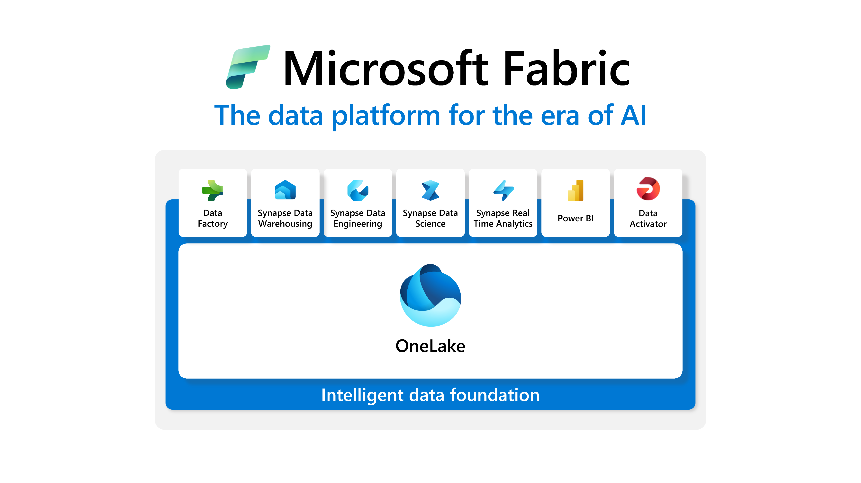

Slide 8
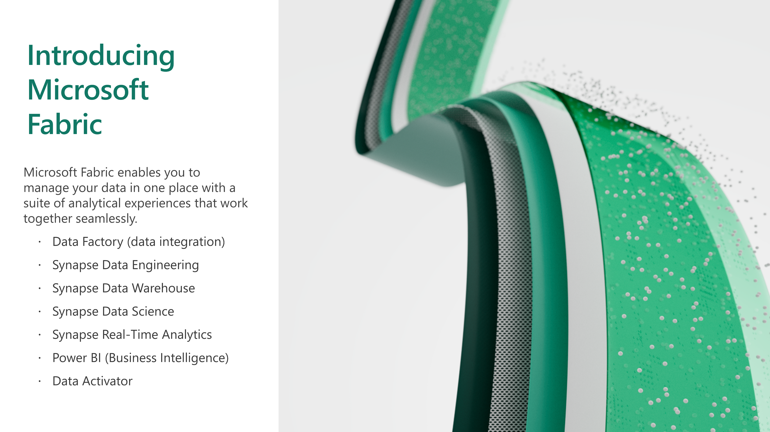

Slide 9
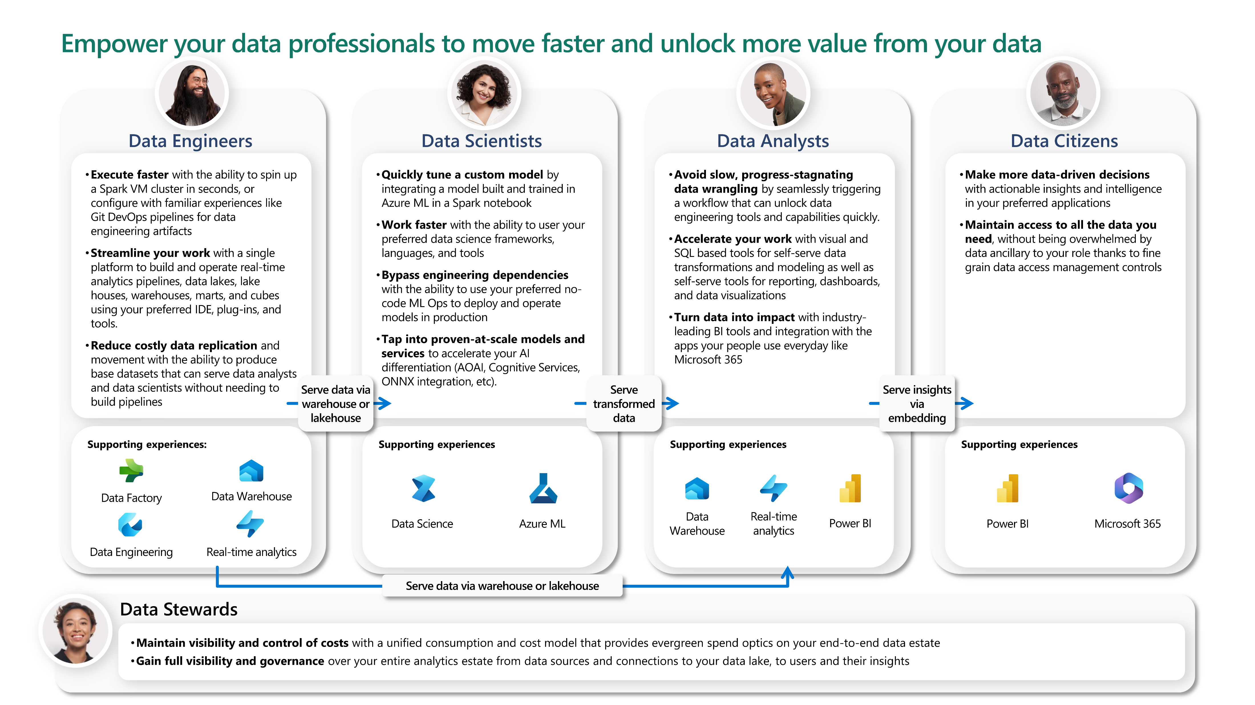

Slide 10
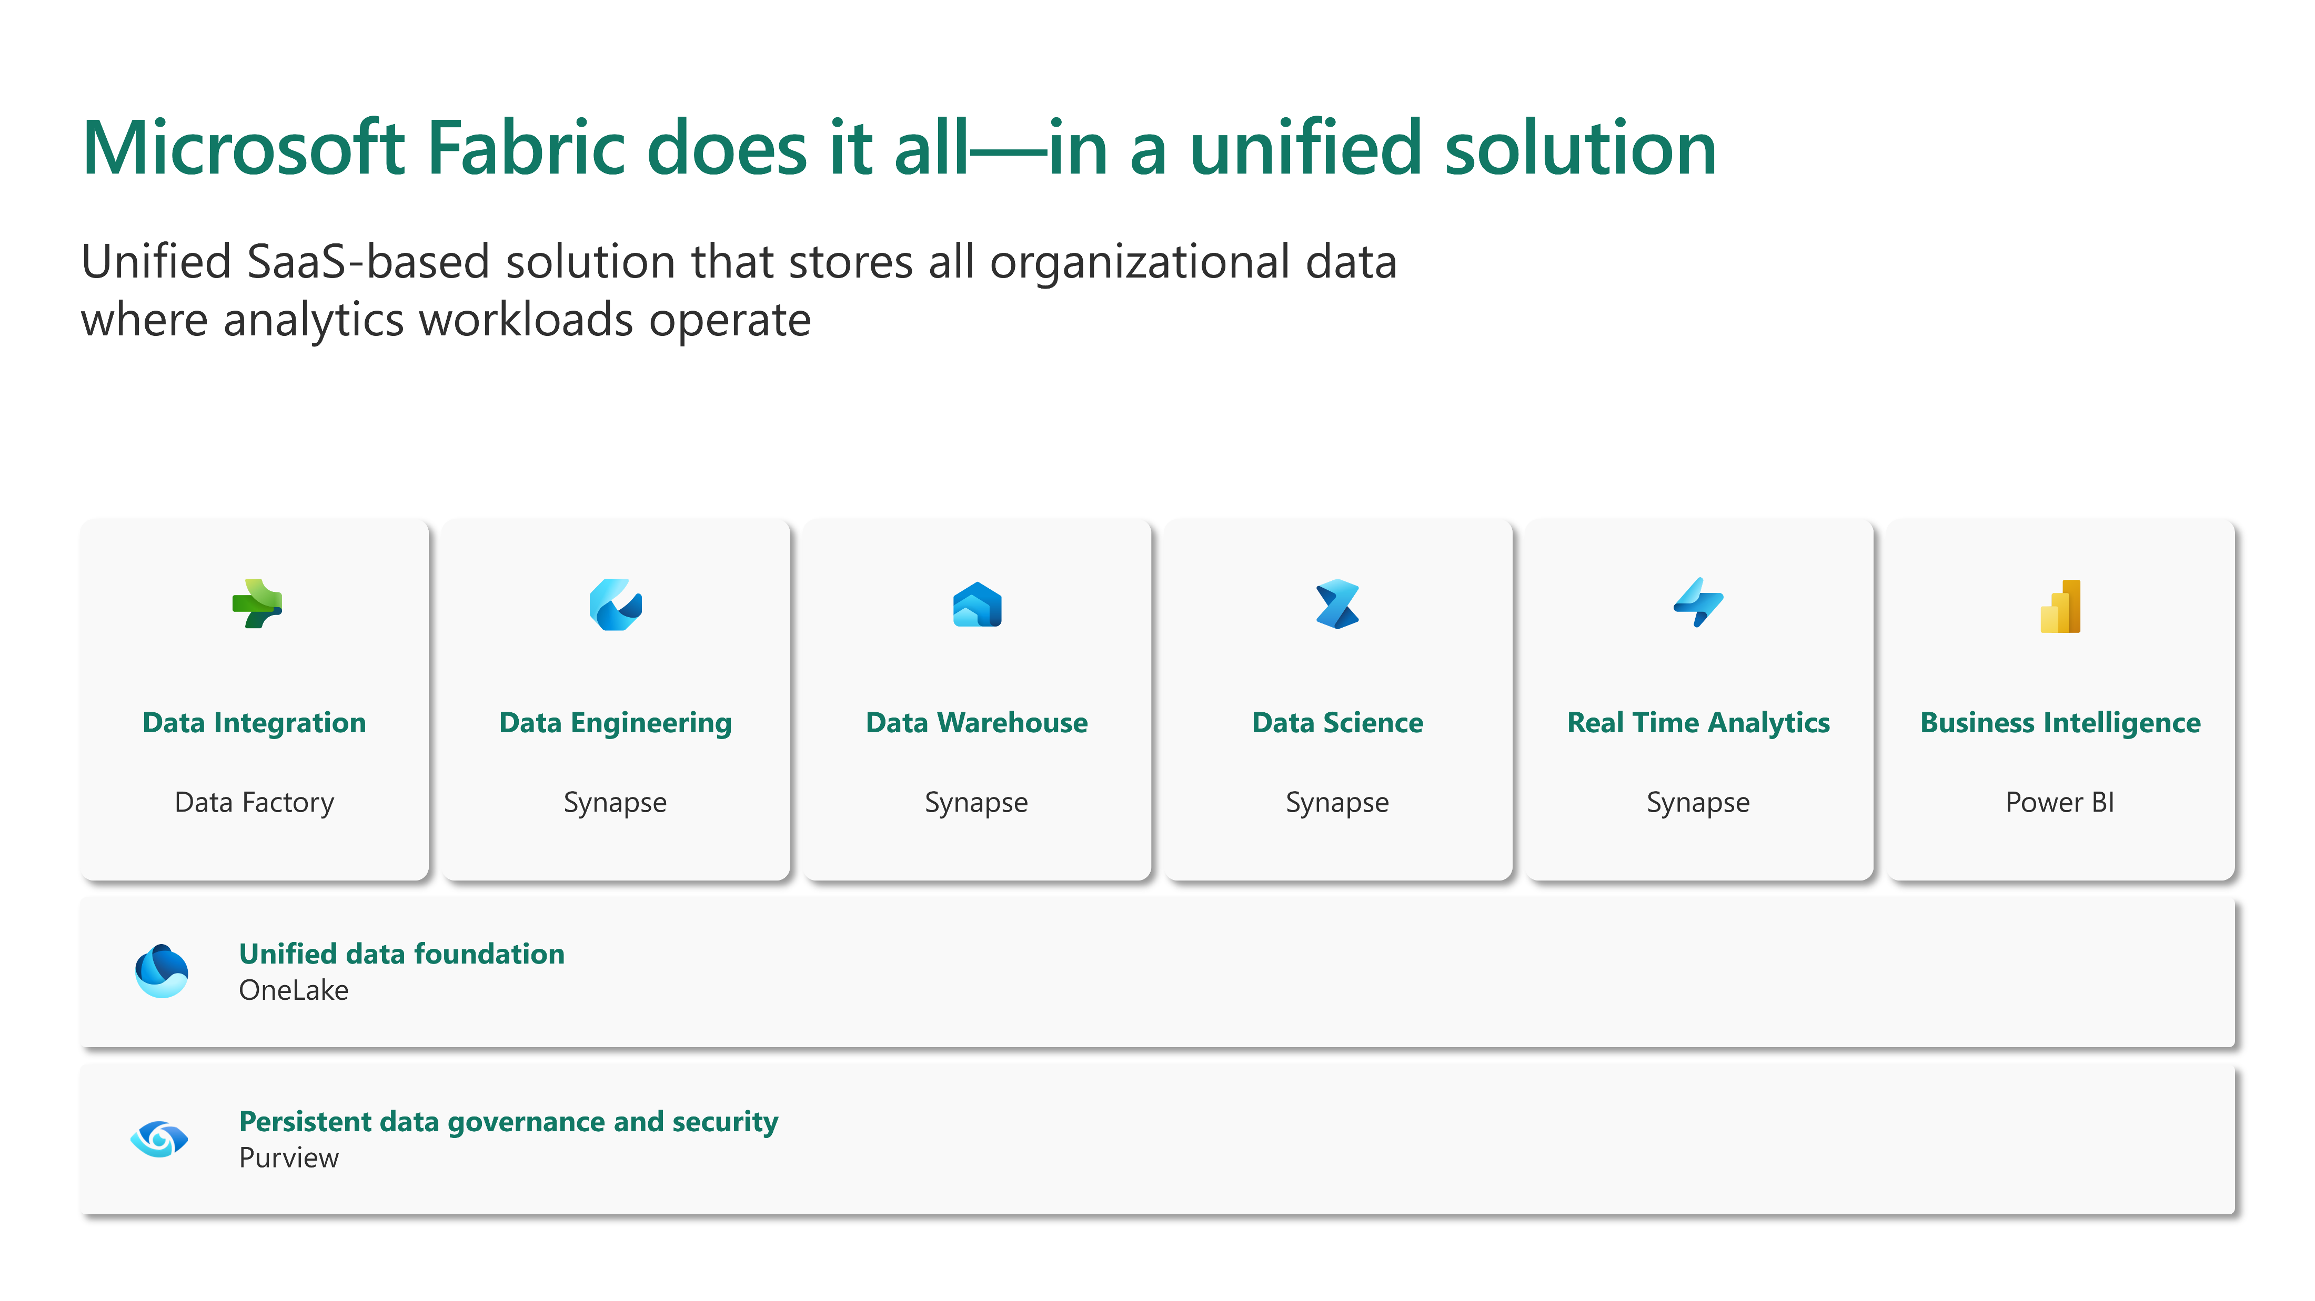

Slide 11
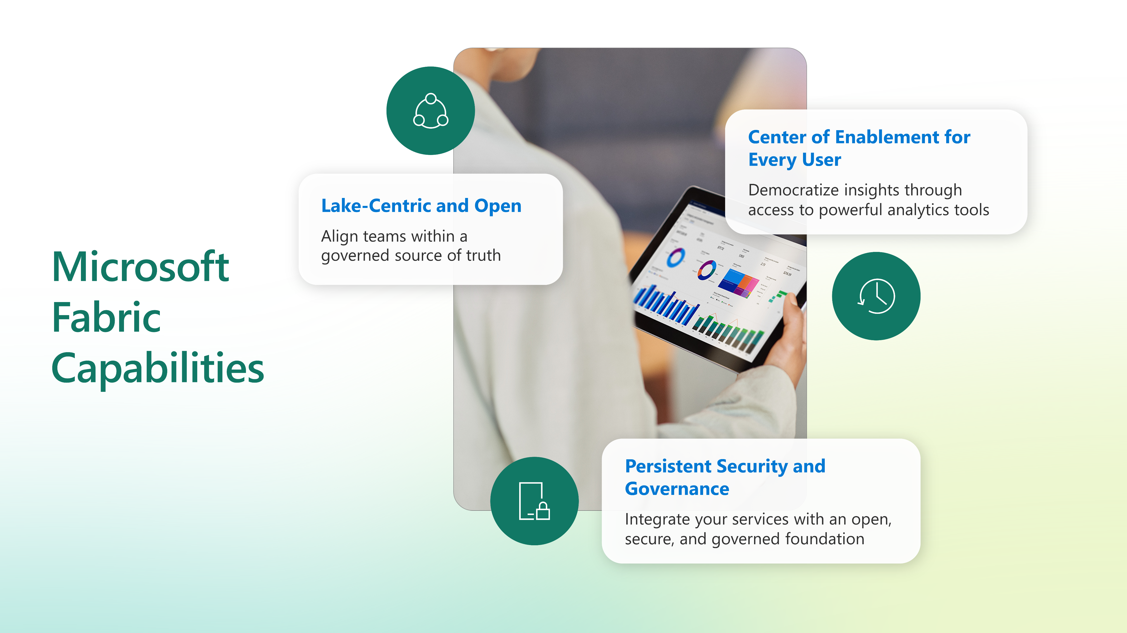

Slide 12
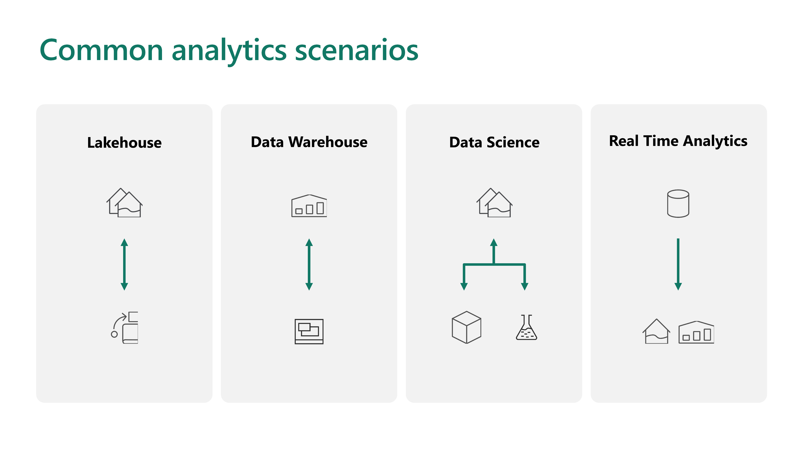

Slide 13
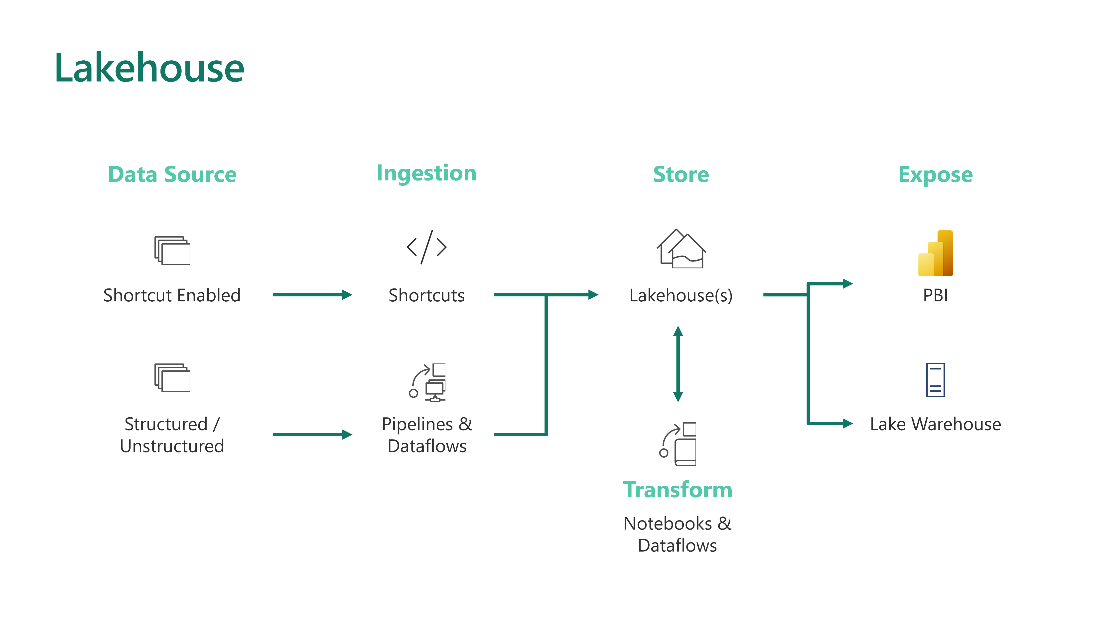

Slide 14
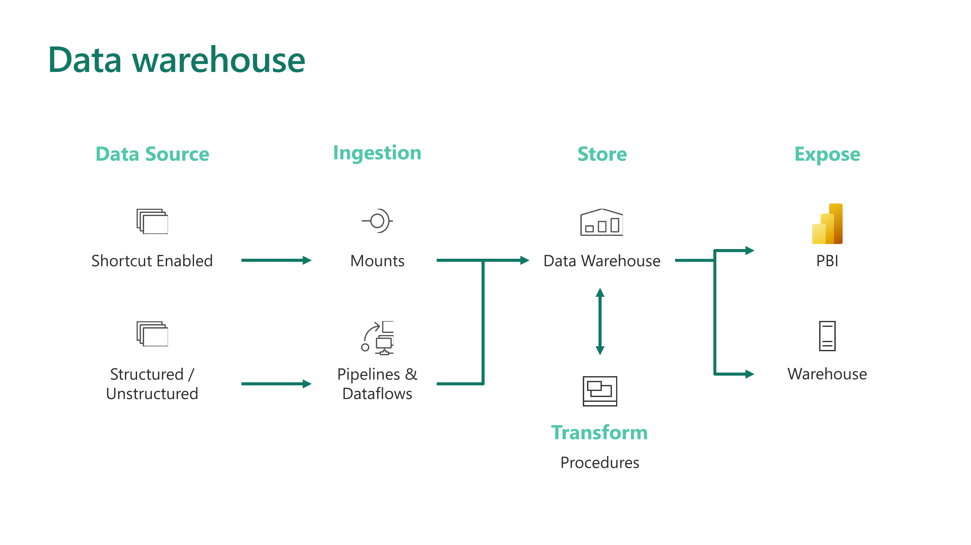

Slide 15
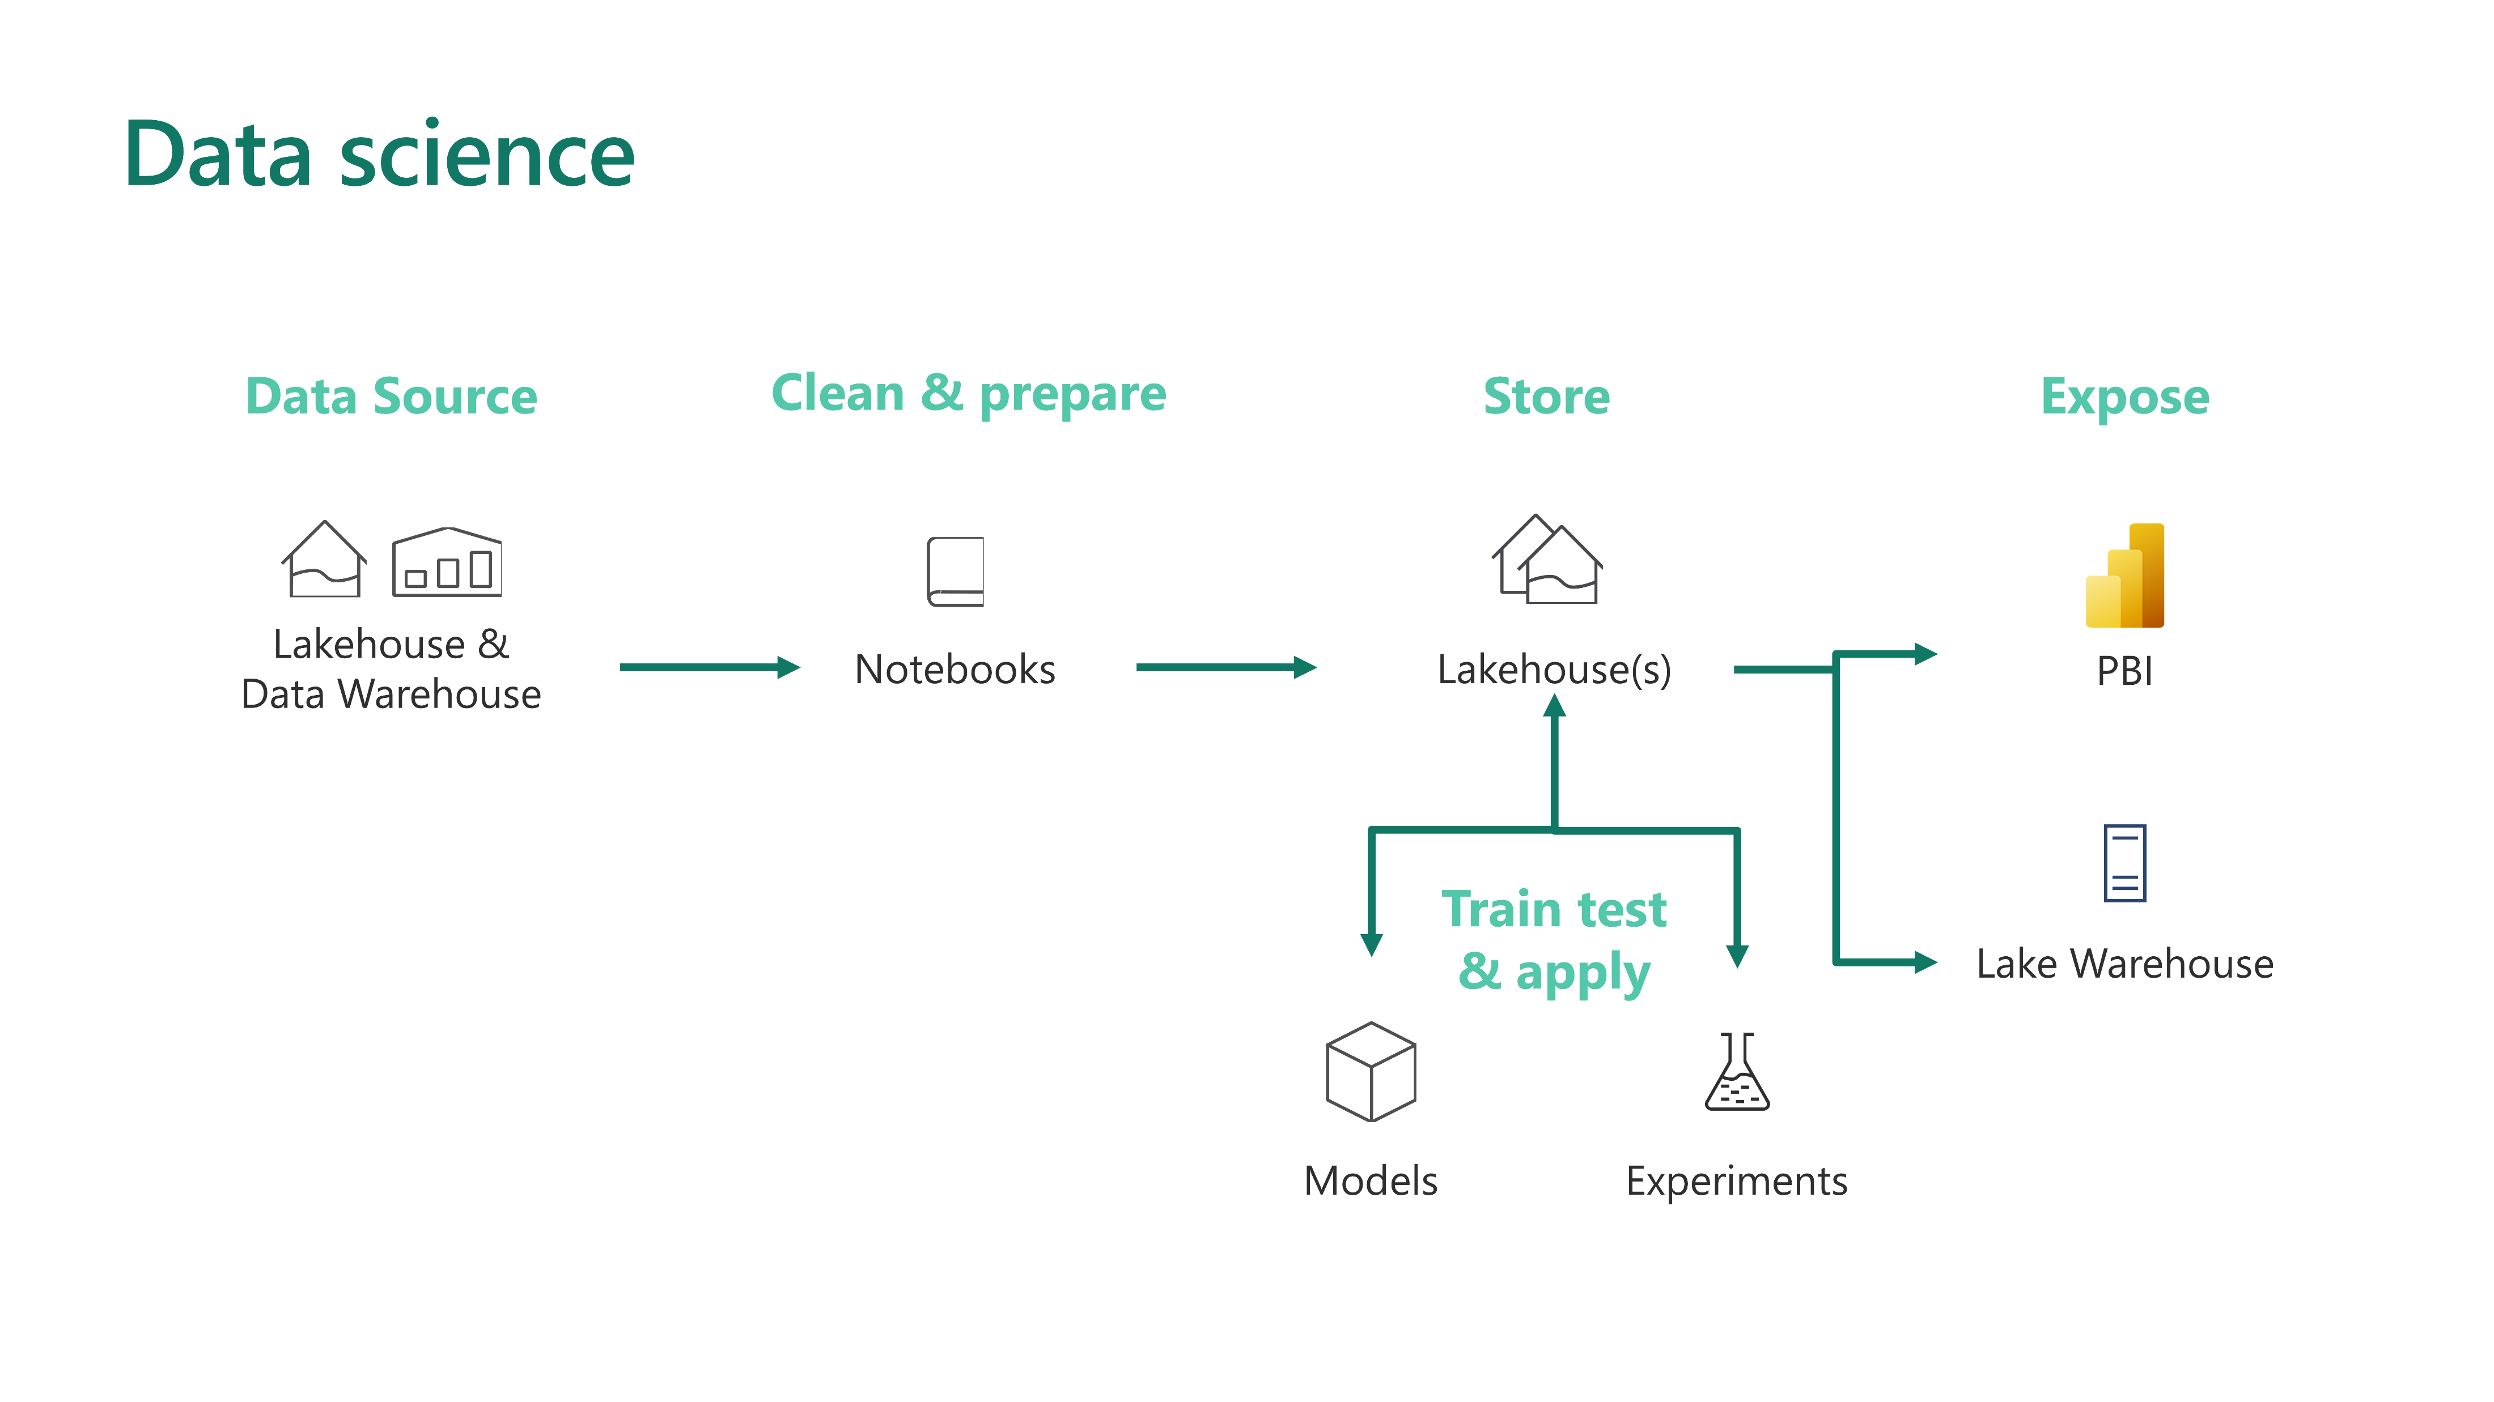

Slide 16
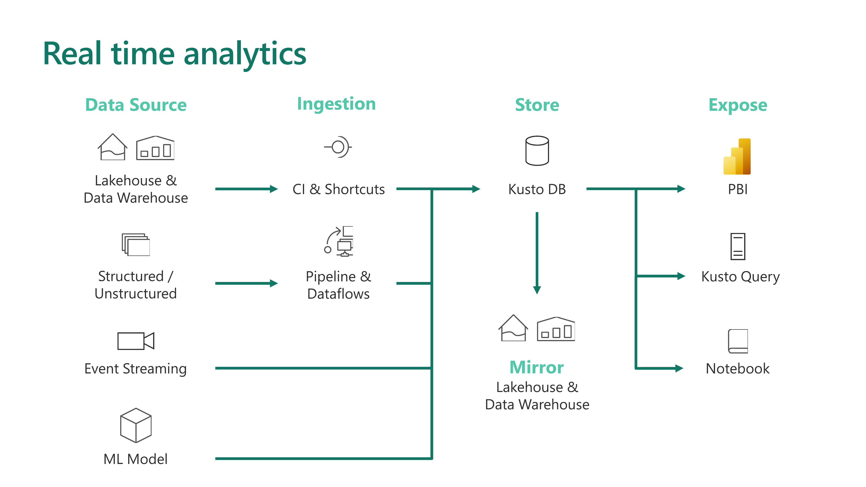

Slide 17
The Hack

Slide 18
The Hack
Margie's Travel is a travel agency specialising in diving holidays.
They have asked you to help them build a solution to allow their customers to explore the possibilities of diving some of the shipwrecks of Western Australia.
Your task is to use Microsoft Fabric to bring together the data and stories behind these shipwrecks to help boost customer engagement.
Margie's would also like to be able to use this data to help customers assess dive conditions a few days before, and as a basis for on-board dive briefings

Slide 19
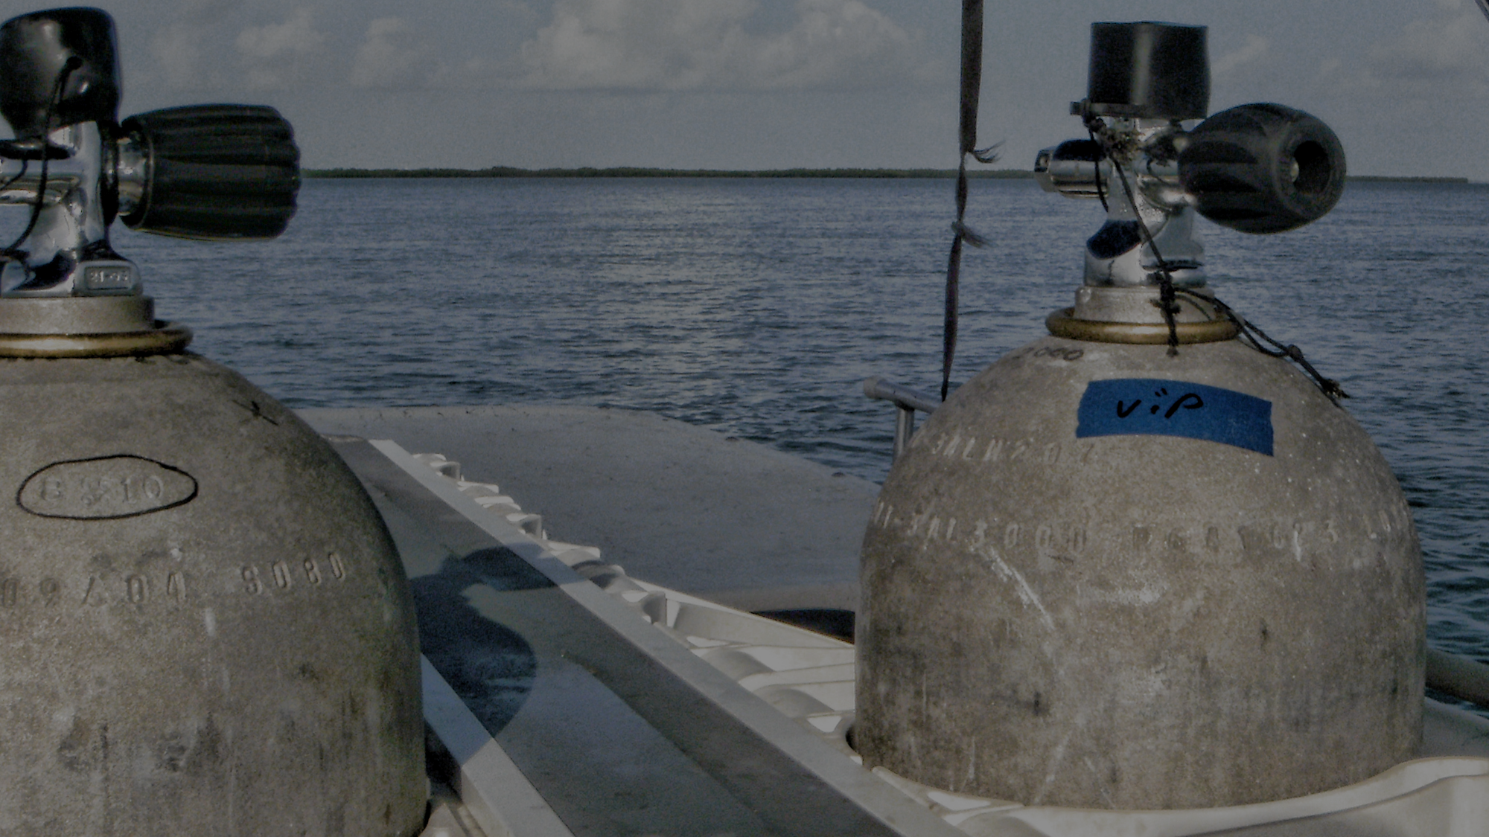
Challenge 0 Get Your Gear Ready
Grab your fins and a full tank!
Notes:
Dive Tanks | OLYMPUS DIGITAL CAMERA | Richard Elzey | Flickr
https://www.flickr.com/photos/54602205@N00/7877399044

Slide 20
Challenge Zero
Get your gear ready!
You will need
A Fabric Subscription
Power BI Desktop
A love of terrible sea-themed puns
Notes:
Modify this slide and add the pre-reqs specific to your hack here.
Each challenge slide should list the key goals for the challenge.

Slide 21
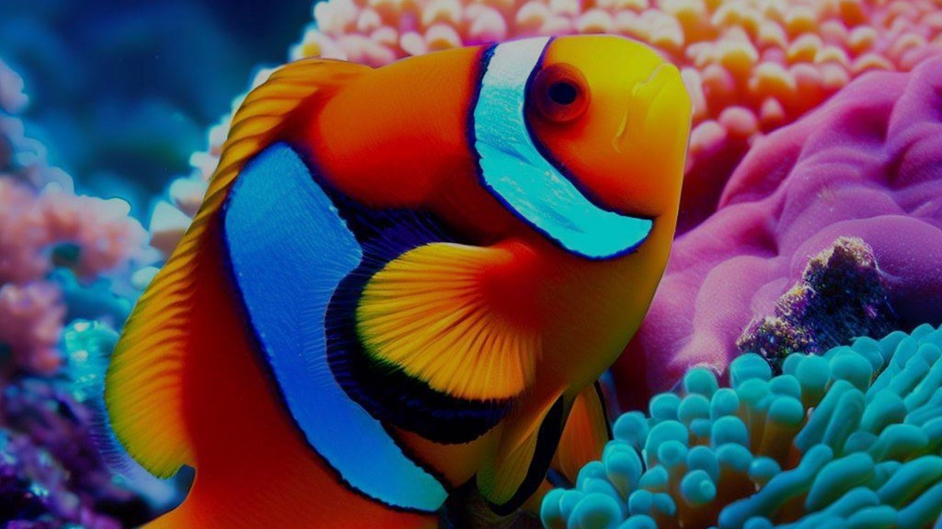
Challenge 1 Finding Data
Data Data Everywhere
Notes:
Obligatory bing.com/create AI generated clownfidh

Slide 22
Challenge 1 Finding Data
Head Out To Sea,
“Plan the dive, dive the plan”
Read the Brief from Margie’s Travel
Catalogue the kinds of data you’ll need
Find them online
Location
Licensing
Identify Applicable Fabric functionality to retrieve, clean and store each dataset

Slide 23
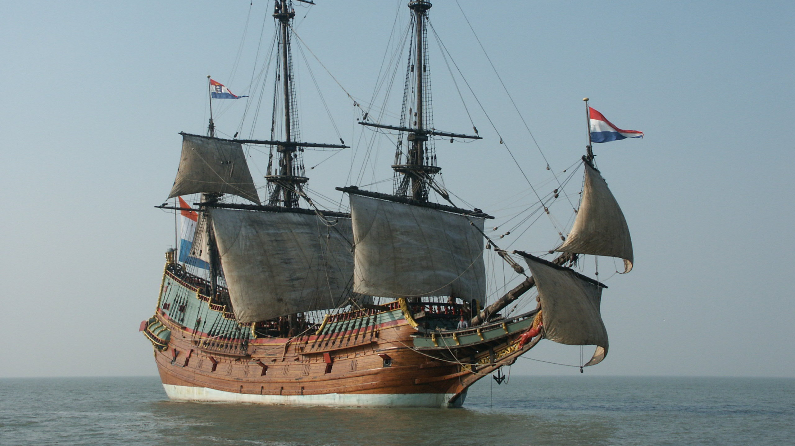
Challenge 2 Land ho!
Land Your Data in OneLake
Notes:
Full scale replica of the Batavia - https://en.wikipedia.org/wiki/Batavia_(1628_ship) – Infamously wrecked off the Western Australia coast, 4 June 1629.

Slide 24
Challenge 2 Land Ho!
Land Your Data in OneLake
Your goal is to land your datasets in OneLake
Automatically retrieve your data
Land as-is (preserve source format)
Remember, there’s lots of ways of retrieving data, maybe try a few?
Notes:
Template for a lecture slide with bullets (if you need them).
Try to NOT use bullet lists in your presentation.
Diagrams, puppy pictures, etc are always better. ☺

Slide 25
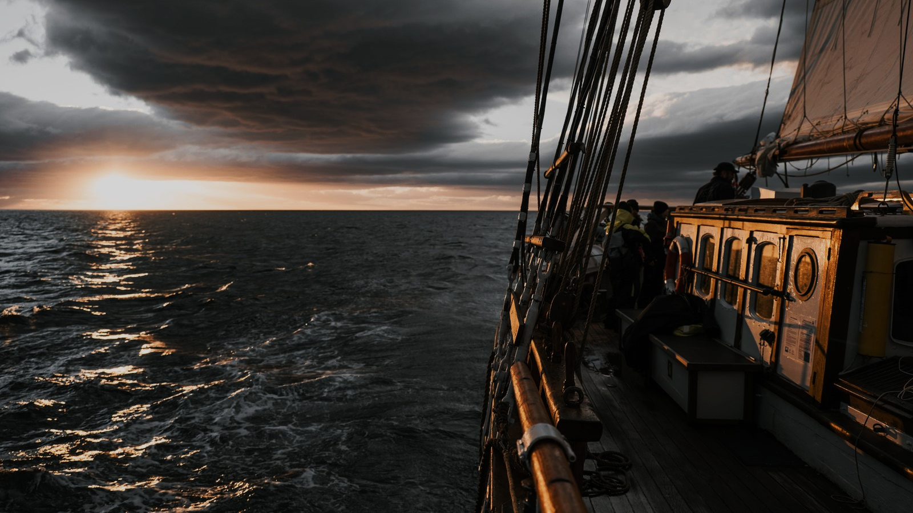
Challenge 3 Swab the Decks!
Get Your Data Ship Shape
Notes:
Wooden ship sailing in ocean during amazing sunset · Free Stock Photo (pexels.com)

Slide 26
Swab the Decks!
Get Your Data Ship Shape
You goal is to prep your data ready for analysis
Gaps? Duplicates? Need More Data?
Success Criteria
Show how you have cleaned your data, and why you chose particular methods
Demonstrate your data is now ready to build a story

Slide 27
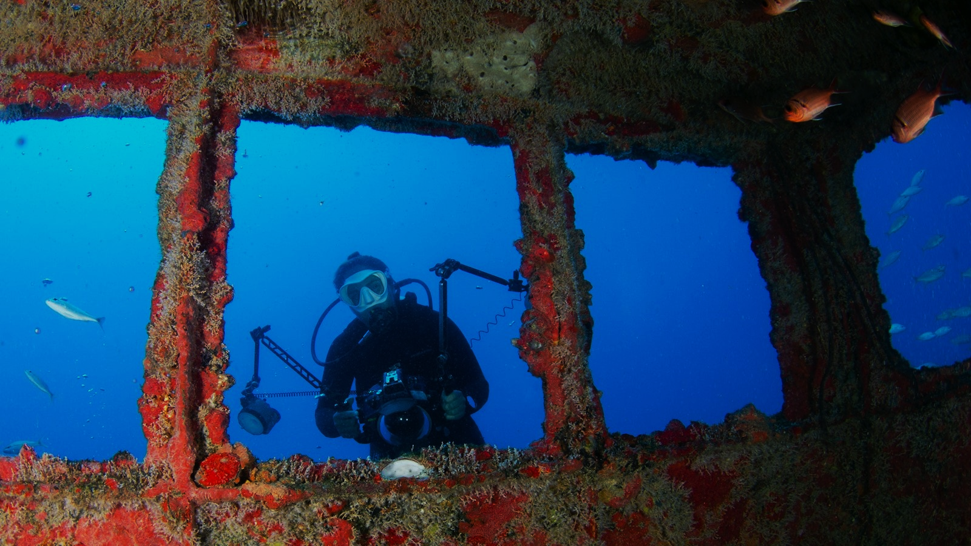
Challenge 4 Make A Splash
Create the Story
Notes:
Underwater Photograph of a Diver with Red Wreck · Free Stock Photo (pexels.com)

Slide 28
Challenge 4 Make a Splash
Create Your Data Story to Impress Margie’s Travel
Now it’s time to create your data story
To complete this challenge successfully, you should:
Create, to portray your findings in a compelling way.
Augment your data with additional sources if you wish, such as photos or links to other resources
Remember: meet the needs of two distinct audiences:
Customers and dive crew
Prepare 1-2 slides to present your solution to Margie's Travel (the rest of the group).
Make it impactful and succinct!
Notes:
For each challenge, list out the key high-level goals.
If there are important specifications, list them here, or remind students to “read the student guide!”

Slide 29
Challenge 5 Giant Stride
Leap In and Share Your Story

Slide 30
Challenge 5 Giant Stride
Share Your Story
You've built a compelling data story! Now it's time to present your findings.
You have 10 mins to present your story
A live demo always makes a splash!

Slide 31
Thank You for Attending!
https://aka.ms/wth
Notes:
Thank students for attending and share the link to the What The Hack website with them.

